Slide 1
Database Management Systems
Presented for: Dr Adel Khelifi
Done By:
Abdullah Al Ameri - 1070401
Areesha Ahmed - 1049798

Slide 2
Introduction
Problem:
low wage employees
High fees relative to income
Risk of account termination
Volunteers proper reward system
Solution:

Slide 3


Outline
Introduction / Overview
01
Business requirements
02
Admin Privelges
03
Database model
04
Entities
Attributes
Relationship matrix
05

Slide 4








Government
Application Account
Program Applicant
Private Company
Business Overview
Payroll Record
Charity
Payroll Escrow
Employee

Slide 5

Business Requirements
1. Requires Government approval to run the Program.
2. The Applicants have to be either from a Private Company or/and Charity.
3. Employees/Volunteers in Private Company or Charity should have a minimum salary of 1000AED.
4. All employees payroll information is saved in the Payroll Record System to help with the program.
5. Each applicant must have a signle escrow account.

Slide 6
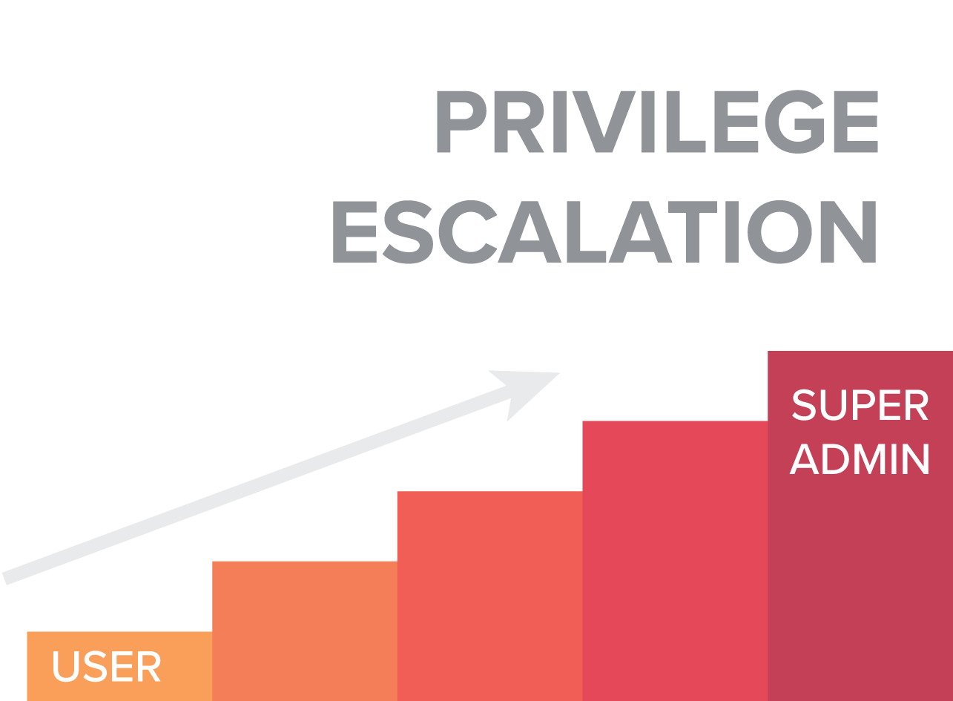
Admin Priveleges
Highest priveleges are provided to government employees.
Full freedom to add/drop business related entities and attributes.
Selected Employees have limited priveleges to update and change payroll data.
Volunteers and most employees do not have admin priveleges.

Slide 7




D A T A B A S E M O D E L

Slide 8
RELATIONSHIP MATRIX
 | GOVERNMENT | PROGRAM APPLICANT | PRIVATE COMPANY | CHARITY COMPANY | EMPLOYEES | CONTACT INFO | PAYROLL ENTITY | PAYROLL RECORD | APPLICATION ACCOUNT | CREDIT CARD ACCOUNT
GOVERNMENT |  | AUTHORIZES
PROGRAM APPLICANT | AUTHORIZED BY |  | HAS USERS FROM | HAS USERS FROM |  | HAS ALL
PRIVATE COMPANY |  | APPLIES FOR |  |  | HIRE |  | GIVES INFORMATION TO | UPDATES
CHARITY COMPANY |  | APPLIES FOR |  |  | HIRE |  | GIVES INFORMATION TO | UPDATES
EMPLOYEES |  |  | HIRED BY | HIRED BY |  |  |  | HIRED BY
CONTACT INFO |  | UPDATED BY
PAYROLL ENTITY |  |  | UPDATED BY | UPDATED BY |  |  |  | UPDATED BY | UPDATES
PAYROLL RECORD |  |  | UPDATED BY | UPDATED BY | HIRE |  | UPDATES |  | UPDATES
APPLICATION ACCOUNT |  |  |  |  |  |  | UPDATED BY | UPDATED BY |  | UPDATES
CREDIT CARD ACCOUNT |  |  |  |  |  |  |  |  | UPDATED BY

Slide 9
SQL
create table GOVERNMENT_PROGRAM (
program_id number(12) GENERATED ALWAYS as IDENTITY(START with 100 INCREMENT by 1),
program_name varchar2(50) NOT NULL,
constraint pk_government_program primary key (program_id)
);

Slide 10
MongoDB
show dbs
use payrollsystem
db
payrollsystem
db.createUser({
user:"Abdulla",
pwd:"secret",
roles:["readWrite",dbAdmin"]});
db.createCollection("creditCard");
db.creditCard.insert({creditCardNumber:"4555 3333 2846 2222", backNumber:"111",pwd:"secret",processingFee:0.015});
show collections

Slide 11
Further Review
https://binharby.github.io/csc302_presentation/

Slide 12

Thank You! Please Ask if You Have Any Questions

